Slide 1
MMME2045
Block P: Designing with Polymers
Dr Reda Felfel
reda.felfel@nottingham.ac.uk

Slide 2
BLOCK P: Designing with Polymers
In this Block we will cover
Introduction
Case Study: Low Pressure Gas Distribution Pipes
Design Requirements
Materials properties and Processing
Other examples of materials selection for:
  Acetabular cup - hip replacement
  Deflection limited design - Snap Clips, bottle tops fasteners
  Elastic Seals
  Elastic hinges – finger implants

Slide 3
MMME2045 UNUK: Learning Objectives
Demonstrate an understanding of process-structure-property interrelationships for polymers in an engineering application
Identify the influencing materials properties for designs and be able to generate a materials selection criteria that can used manually or through software to select appropriate materials for polymer applications
Demonstrate an understanding of the diverse range of materials properties and their associated design requirements.

Slide 4

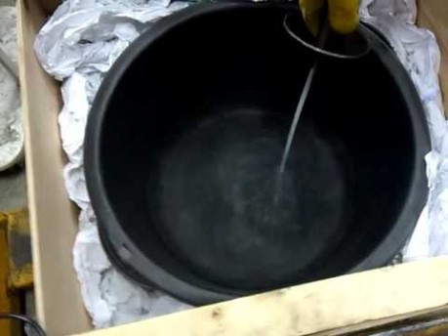
Introduction
Understanding properties of polymers is essential for designing a product
https://www.youtube.com/watch?v=yibNEcn-4yQ&app=desktop
https://www.youtube.com/watch?v=FKIKB0KugZw

Slide 5
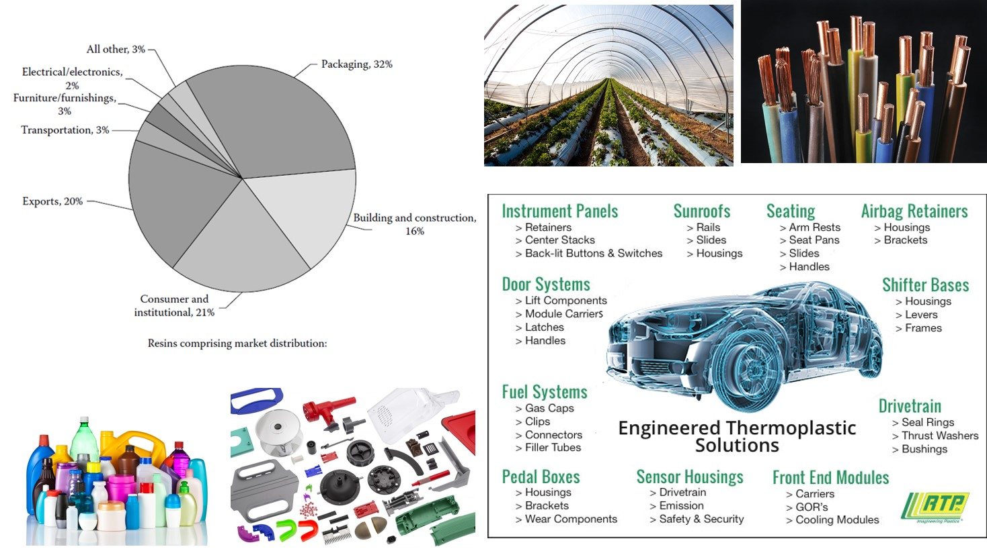
Introduction
Polymers are everywhere !

Slide 6
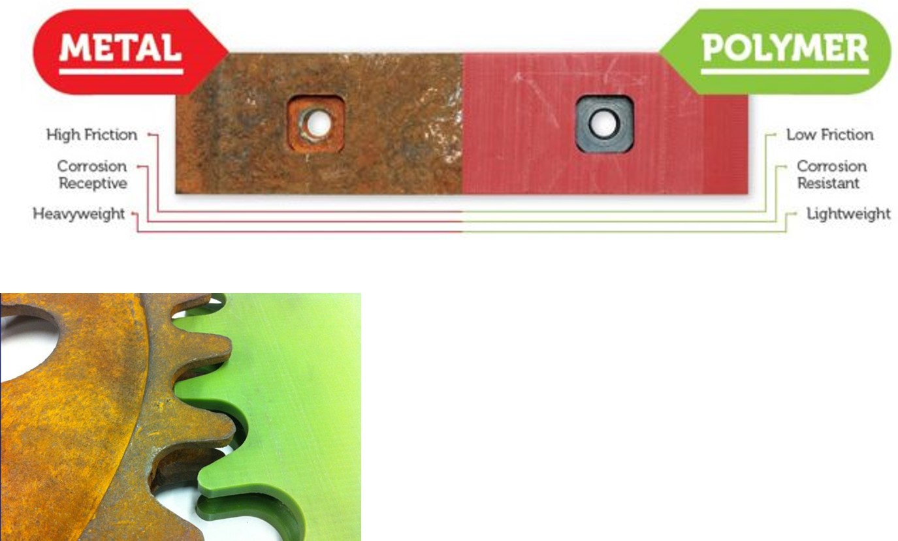
Why Polymers?
Metal vs Polymer
https://www.nylacast.com/

Slide 7
Case Study: Pipes for Low Pressure Gas Distribution
BACKGROUND
UK current depends on gas, see www.gridwatch.templar.co.uk
National High-Pressure Transmission:
The National Transmission System (NTS) operated by National Grid plc. NTS has:
7,600 km of large diameter steel pipelines ( 63 to 1200 mm) and 20 compressor stations
transports gas from terminals to 120 offtakes installations at 85 bar.
  8 regional domestic transmission systems,
  40 large industrial consumers such as power stations at 25 bar.
  8 large-scale storage sites, with 9 more planned
Regional Distribution:
275,000 km of small diameter pipes. Gas pressure is reduced in stages before reaching residential consumers. The volume of gas flowing in the pipeline network itself as buffer storage, called linepack.
Source: Ofgem. Gas Distribution Annual Report for 2007-08. London, UK: Office of the Gas and Electricity Markets; 2009. Available at: https://www.ofgem.gov.uk/publications-and-updates/gas-distribution-annual-report-20072008.
Notes:
Connections to 14 million domestic and industrial consumers, >200,000km
Liquefied natural gas (LNG).
Individual distribution networks have their own gas storage facilities for coping with demand variation and also utilise

Slide 8
Low pressure gas distribution pipes
Where? | Max pressure/bar | Requirements | Materials Used
National Grid | 85 | Max Flow | HSS
Local distribution | 0.075 to 2 | ?? | Cast Iron, PE
Inside House | <0.0735 | Safe durable connections | Cu, Pb
Laboratory | <0.0725 | Flexible connection | Rubber, PVC
Notes:
High-speed steel (HSS)

Slide 9
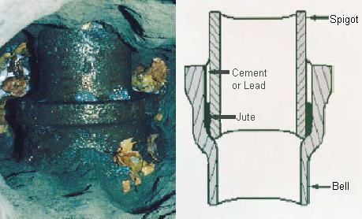
Cast iron was the material of choice for low pressure distribution mains all over the world until the 1950s.
Pipelines typically consist of 12-foot sections connected by bell and spigot joints, shown in that are sealed by jute fabric plus cement or molten lead.
Leaks tend to develop in the packing over time due to heavy overhead traffic, freeze-thaw cycles, naturally shifting soil, and the switch to dryer natural gas.

Slide 10
Cast iron pipes for gas and water
http://www.everythinglubbock.com/story/state-lets-dangerous-gas-pipes-remain-in-north-tex/d/story/n_3tmKOfTEy7GPN-Q7aZKg
Key problems: Corrosion, brittleness, leakage and expertise/time restraints to join.
Replacement of cast iron pipes by polymers started in 1970s and are still being replaced.

Slide 11
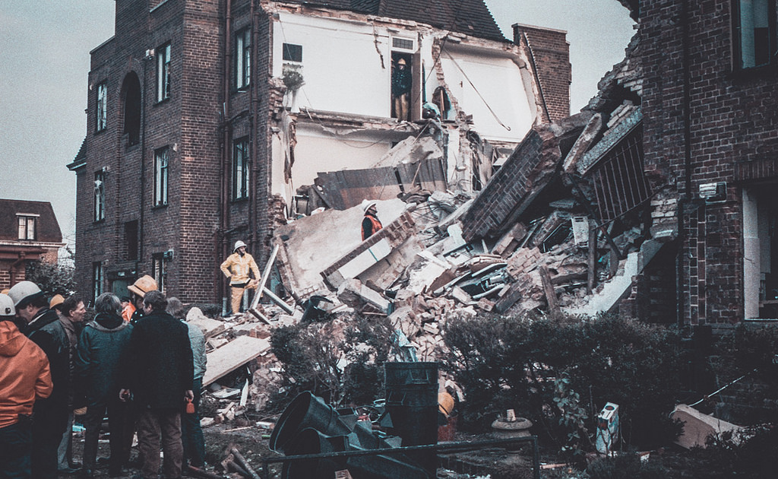
Materials in Design matters: Putney Gas Explosion
Notes:
1985 - 8 killed

Slide 12
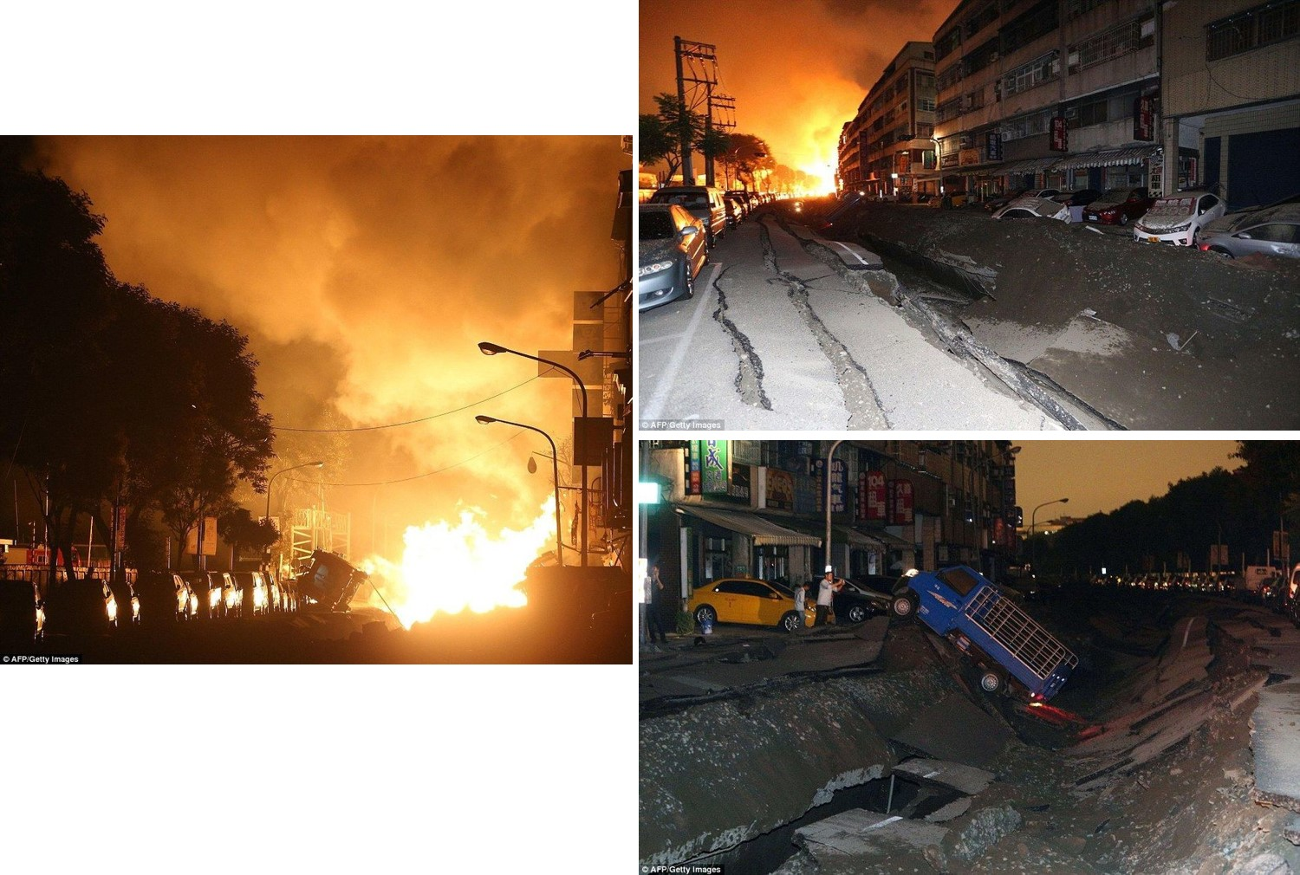
Materials in Design matters: Taiwan Gas Explosion
Link
Notes:
32 died and 321 injured in the disaster

Slide 13

Properties?
Pause the video and list out material properties of concern for a low pressure gas distribution system

Slide 14
Desirable properties?
Chemical stability
Toughness, yield stress
Stiffness
Ease of joining/fusion
Pressure requirements
Creep/creep rupture
Strength
Soil loads
Environmental stress cracking
Defects
Runaway crack growth
Cost

Slide 15
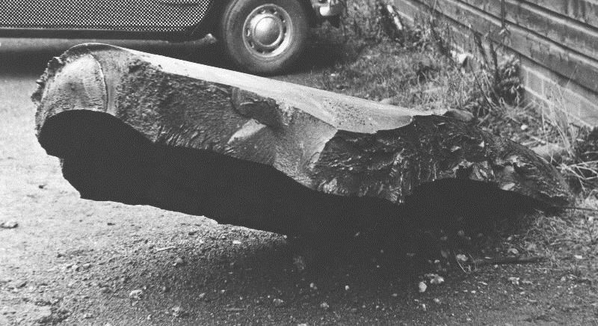
Do not want a brittle failure
Failure of a large steel pressure vessel fabricated in Wolverhampton exploded during hydro-test in 1965
Notes:
1965 Wolverhampton pressure vessel failure went right through factory wall

Slide 16
Case Study: Pipes for Low Pressure Gas Distribution
Function: Gas pipe
Objective: delivering low pressure natural gas ( <2 bar), safely under and over ground with low gas leakage for 50 years at a low installation and manufacturing cost
Constraints: must yield before break, low cost, environmentally and mechanically stable, sufficient toughness and strength, relatively impermeable to gas diffusion…
Free variable: choice of material.

Slide 17
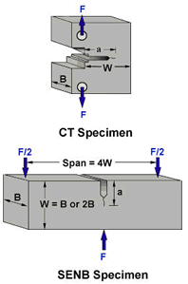
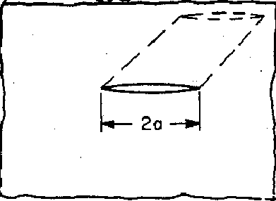
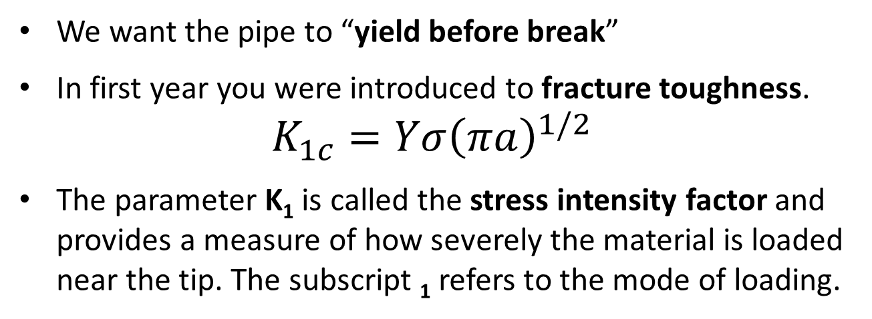
Condition for fracture
We want the pipe to “yield before break”
In first year you were introduced to fracture toughness.
$$K_{1c}=Yσ{\left(πa\right)}^{1/2}$$
The parameter K₁ is called the stress intensity factor and provides a measure of how severely the material is loaded near the tip. The subscript ₁ refers to the mode of loading.
When the stress intensity factor at the tip of a crack reaches a critical value, K_{1c}, the cracked structure will fail.
K_{1c} is called the plane strain fracture toughness of a material often shortened to fracture toughness.
Y is dimensionless and depends on shape of the structure, while a is related to the length of the crack, for example a through crack has length 2a while an edge crack has length a.
Notes:
Toughness is a measure of resistance for crack propagation.
Mode I: Opening mode
Mode II: Sliding mode
Mode III: Tearing mode

Slide 18
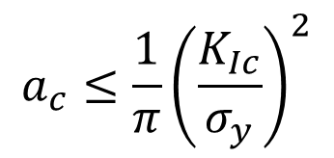
Generating a selection criteria
Thus to prevent plane strain fracture, i.e. a crack exceeding a critical length a_{c} in a polymer pipe of yield stress σ_{y} then
$$a_{c}≤\frac{1}{π}{\left(\frac{K_{Ic}}{σ_{y}}\right)}^{2}$$
This is called a “Ductility factor”
And we can use this as a Performance Index to rank the polymers directly

Slide 19

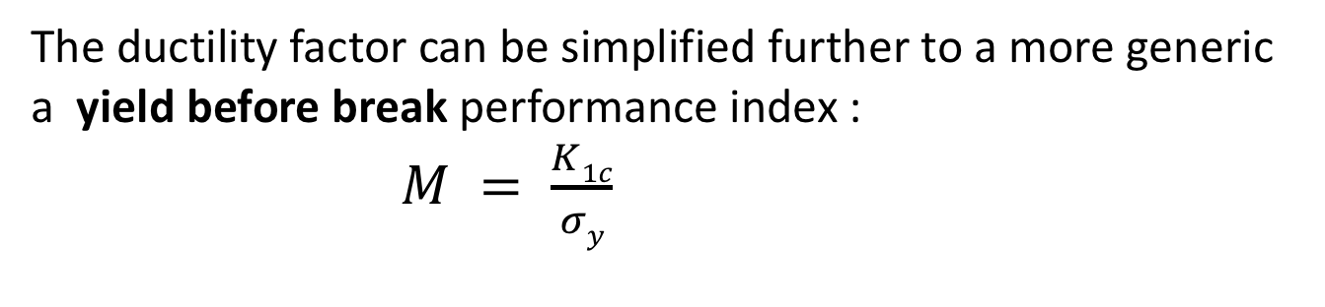
Ductility Factor
Polymer | K_{1C} /MN.m^{-3/2} | σ_{y}/MN.m⁻² | Ductility factor
Polyethylene (PE) | 5.0 | 15.8 | 31.8 mm
Polypropylene | 3.5 | 26.4 | 5.59 mm
Polyvinyl Chloride | 4 | 57.0 | 1.57 mm
Polymethylmethacrylate | 1.4 | 80 | 0.10 mm
Polycarbonate | 3 | 79 | 0.46 mm
$$a_{c}=\frac{1}{π}{\left(\frac{K_{Ic}}{σ_{y}}\right)}^{2}$$
The ductility factor can be simplified further to a more generic a yield before break performance index :
$M = \frac{K1c}{σy}$

Slide 20
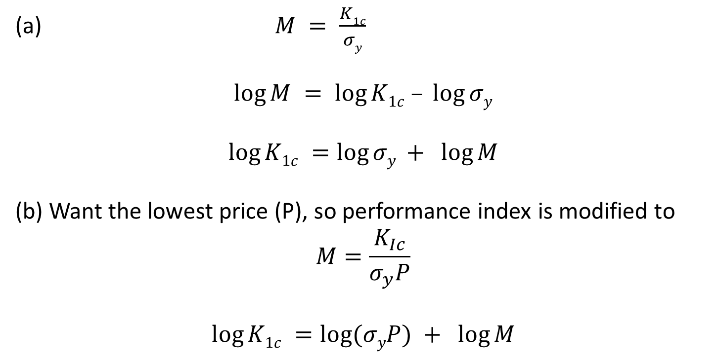
PQ1 Polymer Question 1
(a) Rearrange the yield before break performance index into a form that can be used on a suitable selection chart.
(b) Modify the Performance index to include Price per kg material, P
(a) $M = \frac{K1c}{σy}$
$$log⁡M = log⁡K1c – log⁡σy$$
$$log⁡K1c =log⁡σy + log⁡M$$
(b) Want the lowest price (P), so performance index is modified to
$$M=\frac{K_{Ic}}{σ_{y}P}$$
$$log⁡K1c =log⁡(σyP) + log⁡M$$

Slide 21
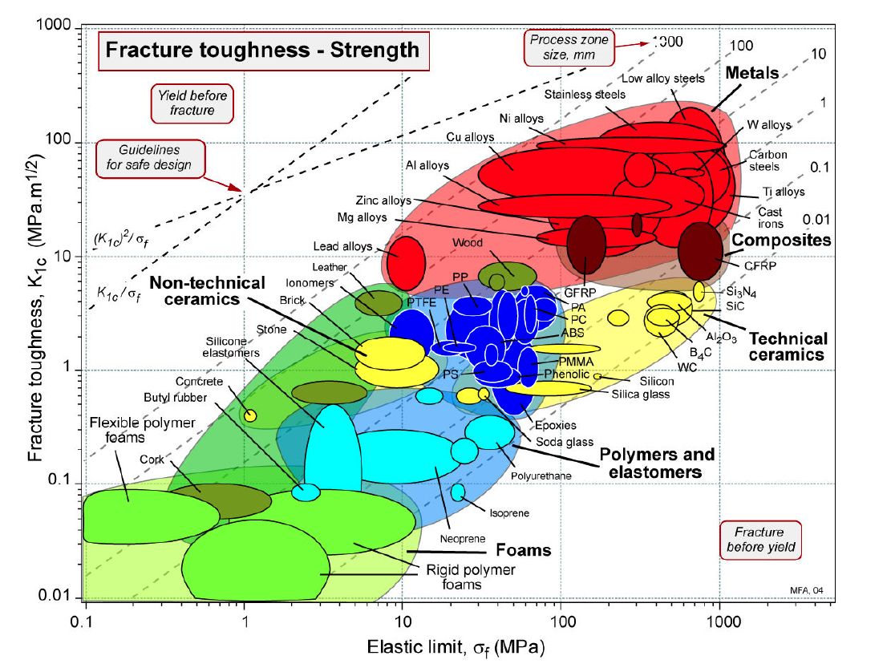
Selection Chart

Slide 22
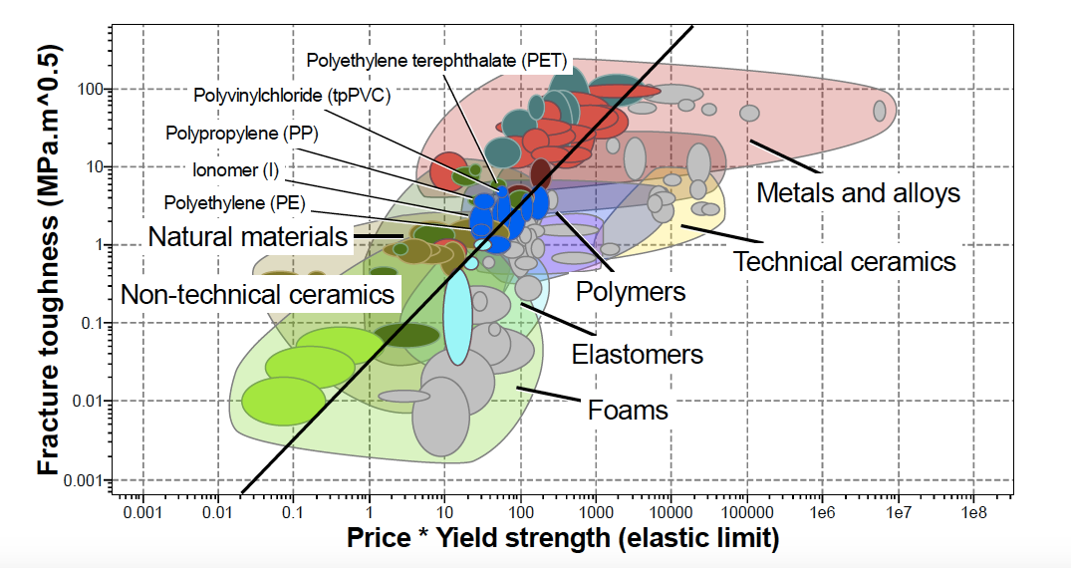
Use CES to chart including price
Notes:
Ionomers are polymer materials made of thermoplastic resins stabilized by ionic cross-linkers

Slide 23
Cost per what?
Material | Price /£ tonne⁻¹ | Price /£ m⁻³
Thermoplastics
polyethylene, HDPE | 450 | 432
polyethylene, LDPE/LLDPE | 460 | 420
polypropylene | 475 | 437
PVC (unplasticized) | 500 | 530
polystyrene /HIPS | 730/780 | 775/825
PET bottle grades | 900 | 1220
polyester SMC/DMC | 1300/1400 | 2270/2450
acrylonitrile-butadiene-styrene, ABS | 1500–1800 | 1530–1835
nylon 6 | 2550 | 2855
polycarbonate, PC | 2700 | 3270
polysulphone, PSu | 7500 | 9300
liquid crystal polymers, LCPs | 17 500 | —
PEEK | 45 000 | 5850
Metals
lead | 405 | 4600
zinc | 680 | 5180
aluminium | 980 | 2650
copper | 1560 | 13 930
tin | 3560 | 26 000
nickel | 4360 | 38 800
Mild steel | 400 | 3150
Rubbers
standard Malaysian rubber (SMR) | 790 | 730
SBR 1712 | 870 | 820
neoprene | 1975 | 2430

Slide 24
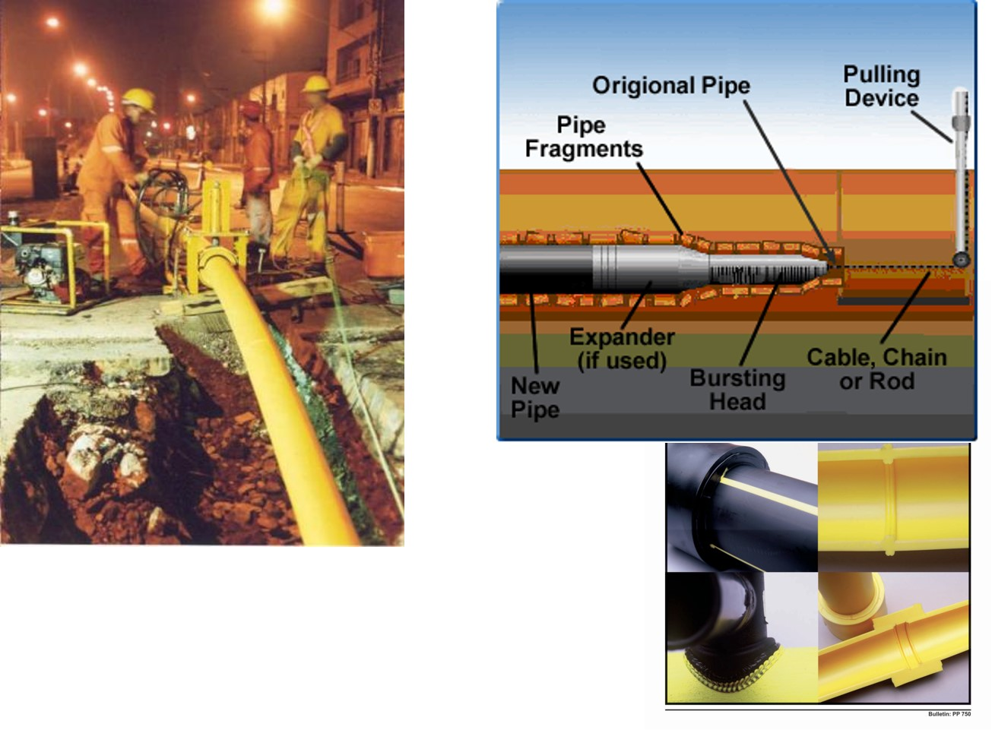
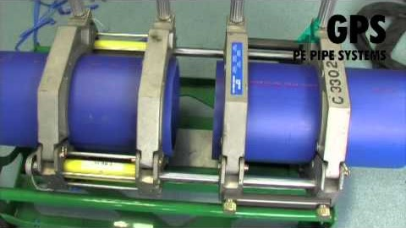
Other constraints?
Pipeline and Gas Journal 2009 Vol. 236 No. 9
Video: Joining the pipes
https://www.youtube.com/watch?v=fq3I8N4ygQI&app=desktop
Notes:
Come in LD, MD, HD and UHMW forms
Lower Tm for PE than PP (160C). MDPE 130C LDPE 120C
Resists dirt
Polyethylene is inert, translucent and creates a lower static charge than polypropylene. That makes polyethylene a candidate to be a sleeve to house collectible documents. It is "inert" and cannot product mold or mildew. It is also translucent in nature so it allows less light through it than polypropylene.
Low static charge

